Slide 1

CSS Game Project
By Group 6:
VLADIMIR TOCARI
DAVOOD ARZAGHI-HARIS
TINGTING SONG

Slide 2
About the game: Boost your Brain
Math Game
In the game you have moving images with numbers
Your goal is clicking on them collect in total 40 points
Time: 30s duration

Slide 3
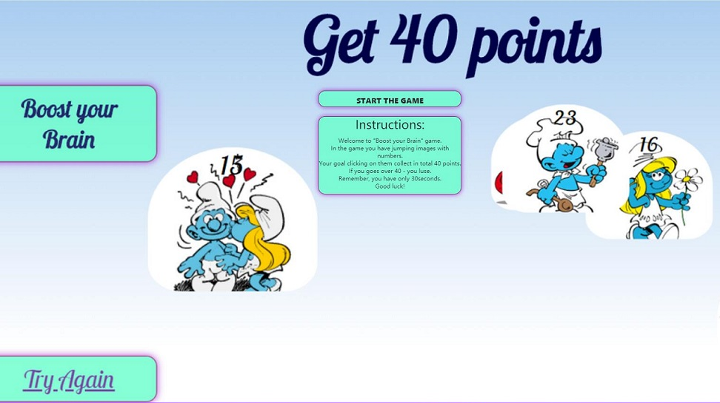
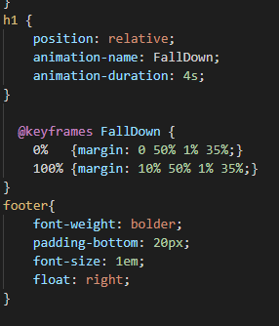
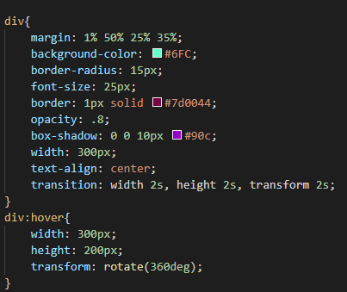
Main Page: -CSS transform Property - CSS Transitions - CSS Animations

Slide 4
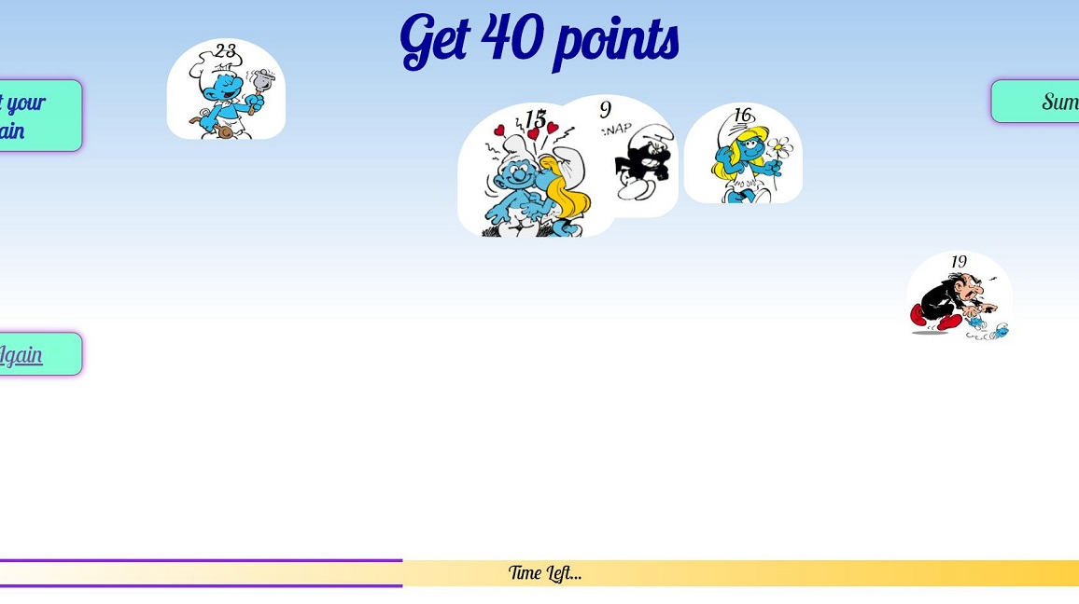
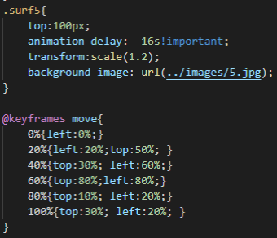
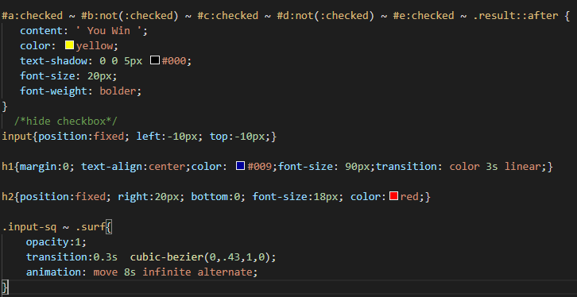
Game: - CSS transform Property - CSS Transitions - CSS Animations - CSS cursor Property - CSS Selectors

Slide 5
CSS Techniques
Transition
show color effect on text;
Instructions size changing;
Transform
use rotate, scale, translate to show numbers images;
Instructions rotate effect on hover;

Slide 6
CSS Techniques
Animation:
movement for all the numbers;
Timer;

Slide 7
Inspired From:
Kill The Birds: https://codepen.io/elad2412/pen/hBaqo

Slide 8

Thanks!

